Slide 1
WARNING
These slides are not optimized for printing or exam preparation. These are for lecture delivery only.
These slides are made for PowerPoint 2010. They may not show up well on other PowerPoint versions. You can download PowerPoint 2010 viewer from here.
These slides contain a lot of animations. For optimal results, watch in slideshow mode.

Slide 2
foo()
bar()
Main

Slide 3

foo()
bar()
Main

Slide 4
We need a way to organize all this code!

Slide 7
???
int i
i=5
????
MOV AL, 1h
MOV CL, 2h
MOV DL, 3h
????
110010101001101110101010101010101010

Slide 8
High-Level Languages
int i
i=5
ASSEMBLY
MOV AL, 1h
MOV CL, 2h
MOV DL, 3h
BINARY
110010101001101110101010101010101010

Slide 9
High-Level Languages
int i
i=5
ASSEMBLY
MOV AL, 1h
MOV CL, 2h
MOV DL, 3h
BINARY
110010101001101110101010101010101010

Slide 10
Programming Paradigms
[Styles of structuring a solution]
High-Level Languages
int i
i=5
ASSEBLY
MOV AL, 1h
MOV CL, 2h
MOV DL, 3h
BINARY
110010101001101110101010101010101010

Slide 11
PROCEDURAL
function1
function 2
---------------
array
list
High-Level Languages
int i
i=5
ASSEBLY
MOV AL, 1h
MOV CL, 2h
MOV DL, 3h
BINARY
110010101001101110101010101010101010

Slide 12
PROCEDURAL
function1
function 2
---------------
array
list
High-Level Languages
int i
i=5
ASSEBLY
MOV AL, 1h
MOV CL, 2h
MOV DL, 3h
BINARY
110010101001101110101010101010101010
FUNCTIONAL
function1
function 2

Slide 13
Functional
Scheme Clojure Erlang Haskell
F#
FUNCTIONAL
function1
function 2

Slide 14
Functional
Scheme Clojure Erlang Haskell
F#
FUNCTIONAL
function1
function 2

Slide 15
PROCEDURAL
function1
function 2
---------------
array
list
High-Level Languages
int i
i=5
ASSEBLY
MOV AL, 1h
MOV CL, 2h
MOV DL, 3h
BINARY
110010101001101110101010101010101010
FUNCTIONAL
function1
function 2
Java (since version 8)

Slide 16
OBJECT-ORIENTED
PROCEDURAL
function1
function 2
---------------
array
list
High-Level Languages
int i
i=5
ASSEBLY
MOV AL, 1h
MOV CL, 2h
MOV DL, 3h
BINARY
110010101001101110101010101010101010
OBJECT-ORIENTED
FUNCTIONAL
function1
function 2

Slide 18
OBJECT-ORIENTED
PROCEDURAL
function1
function 2
---------------
array
list
High-Level Languages
int i
i=5
ASSEBLY
MOV AL, 1h
MOV CL, 2h
MOV DL, 3h
BINARY
110010101001101110101010101010101010
FUNCTIONAL
function1
function 2

Slide 19
OBJECT-ORIENTED
PROCEDURAL
function1
function 2
---------------
array
list
High-Level Languages
int i
i=5
ASSEBLY
MOV AL, 1h
MOV CL, 2h
MOV DL, 3h
BINARY
110010101001101110101010101010101010
OBJECT-ORIENTED
FUNCTIONAL
function1
function 2

Slide 20
Let’s follow real world
OBJECT-ORIENTED

Slide 21

Object collaborating to calculate the average age of the class

Slide 22
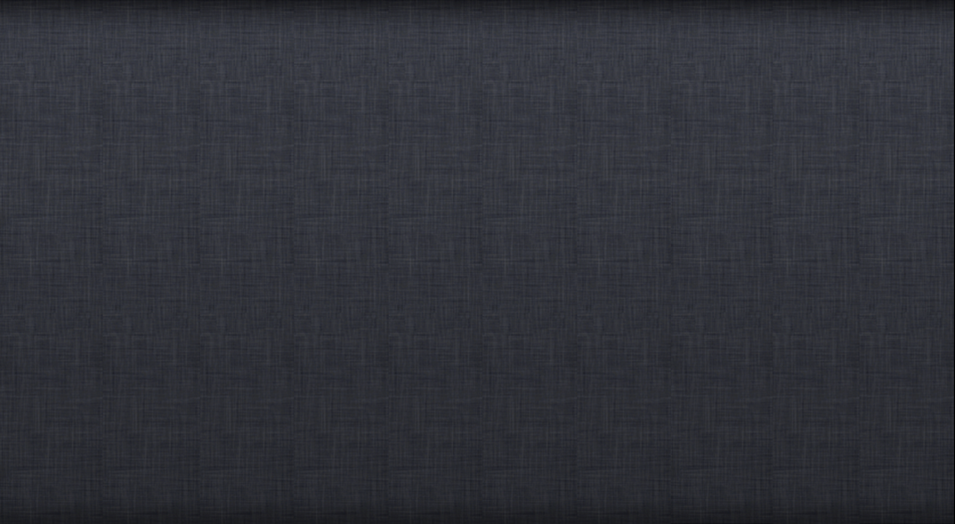
World = a network of objects collaborating by way of message + response
Let’s follow real world
OBJECT-ORIENTED

Slide 23
Let’s follow real world
→ intuitive
OBJECT-ORIENTED
→ efficient?
OBJECT-ORIENTED
Object [ Data + related functions]
Structure solution as collaborating objects.

Slide 24
OOP Language
OBJECT-ORIENTED
PROCEDURAL
function1
function2
--------------------
array
list
FUNCTIONAL
function1
function2
function3
Object [ Data + related functions]
Object [ Data + related functions]
Object [ Data + related functions]

Slide 25
OOP Language
OBJECT-ORIENTED
PROCEDURAL
function1
function2
--------------------
array
list
FUNCTIONAL
function1
function2
function3
Object [ Data + related functions]
Object [ Data + related functions]
Object [ Data + related functions]
OBJECT –DISORIENTED
function1
function2
--------------------
array
list
Object [ Data + unrelated functions]

Slide 26
OBJECT-ORIENTED
LANGUAGE

Slide 27

OBJECT-ORIENTED
LANGUAGE

Slide 29
OBJECT-ORIENTED
Object [ Data + related functions]
Object [ Data + related functions]
Object [ Data + related functions]

Slide 30
Object [ Data + related functions]

Slide 31
low level
Less details
More details
X
function
function
Object
Object [ Data + related functions]
Data
Data
Data
function
Data
function
Data
function
Data
Object
Data
function
function
Data
Data
Data

Slide 32
An object
is an
Abstraction
of
lower level behavior and data
X
function
function
Object
Object [ Data + related functions]
Data
Data
Data
function
Data
function
Data
function
Data
Object
Data
function
function
Data
Data
Data

Slide 33
An object
is an
Abstraction
of
lower level behavior and data
X
function
function
Object
Object [ Data + related functions]
Data
Data
Data
function
Data
function
Data
function
Data
Object
Data
function
function
Data
Data
Data

Slide 34
An object
is an
Abstraction
of
lower level behavior and data
X
function
function
Object
Object [ Data + related functions]
Data
Data
Data
function
Data
function
Data
function
Data
Object
Data
function
function
Data
Data
Data

Slide 35
Abstraction
Object
function
function
Data
function
Data
Data

Slide 37
Object [ Data + related functions]
f2
function1
data1
data2
function3

Slide 38
Encapsulates
f2
function1
data1
data2
function3

Slide 39
Encapsulates
f2
function1
data1
data2
function3

Slide 40
Encapsulates
f2
function1
data1
data2
function3

Slide 41
Encapsulates
f2
function1
data1
data2
function3

Slide 42
Encapsulates
f2
function1
data1
data2
function3
Interface/implementation separation

Slide 43

Encapsulates
Interface/implementation separation

Slide 44
Encapsulates
Interface/implementation separation

Slide 45
Encapsulates
Interface/implementation separation

Slide 46
Encapsulates
f2
function1
data1
data2
function3

Slide 47
An object
Encapsulates
closely -related behavior and data
f2
function1
data1
data2
function3

Slide 48
OO program at runtime…
f2
function1
data1
data2
function3
f2
function1
data1
data2
function3
f2
function1
data1
data2
function3

Slide 50
OOP: Classes

Slide 53
Class
A blueprint for creating objects.
Class: Student
Class: Admin
Data = DOB
Behavior = getAge()
Behavior = calculateAvgAge()
Data = students
Object structure

Slide 55
Class
A blueprint for creating objects.
Class: Student
Class: Admin
Data = DOB
Behavior = getAge()
Behavior = calculateAvgAge()
Data = students

Slide 56
Class-level members
Class: Student
Data = DOB
Behavior = getAge()
totalStudents

Slide 57
Class-level members
Class: Student
Data = DOB
Behavior = getAge()
totalStudents
getTotalStudents()

Slide 58
